Slide 1
IIR Digital Filter Design

Slide 2
Introduction
Digital Filter
-- One of the most widely used complex signal processing operations is filtering, whose main objective is to alter the spectrum according to some given specifications. The system implementing this operation is called a filter. The discrete-time system for the treatment of discrete-time signal is called a digital filter.

Slide 3
Introduction
Classification of Digital Filter
According to the characterization of the eliminated frequency component, the digital filters are usually classified as:
Classical filters
The useful frequency components in input signal are different from the eliminated frequency components.
Modern filters
The signal is aliased into interferer frequency component.

Slide 4
Introduction
Classification of Digital Filter
According to magnitude characteristics of the transfer function, the Classical filters include:
Lowpass filters
Highpass filters
Bandpass filters
Bandstop filters.

Slide 5
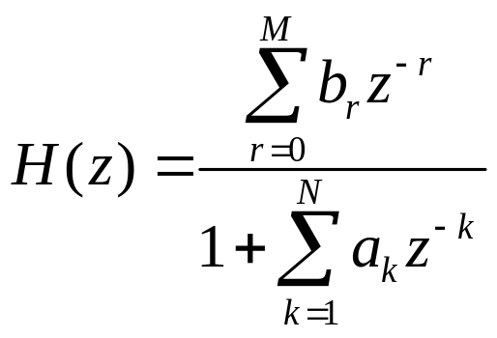
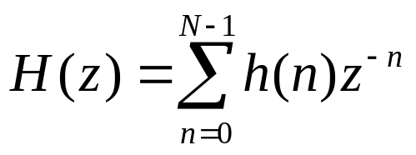
Introduction
According to the length of their impulse response sequences, the digital filters are usually classified as:
Infinite impulse response (IIR) filters
Finite impulse response (FIR) filters

Slide 6
Introduction
An important step in the development of a digital filter is the determination of a realizable transfer function H(z) approximating the given frequency response specifications. The process of deriving the transfer function H(z) is called digital filter design.

Slide 7
Concepts on Digital Filter
Digital Filter Specification
As in the case of the design of analog filters, either the magnitude and/or the phase response is specified for the design of a digital filter for most application.
In most practical applications, the problem of interest is the development of a realizable approximation to a given magnitude response specification. The phase response of the filter can be corrected by cascading it with an allpass filter.

Slide 8
Concepts on Digital Filter
Since the impulse response corresponding to each of these is noncausal and of infinite length, these ideal filters are not realizable.
One way of developing a realizable approximation to these filters would be to truncate the impulse response for a lowpass filter.

Slide 9
Concepts on Digital Filter
The magnitude response specifications of a digital filter in passband and in the stopband are given with some acceptable tolerances.
A transition band is specified between the passband and the stopband to permit the magnitude to drop off smoothly.

Slide 10
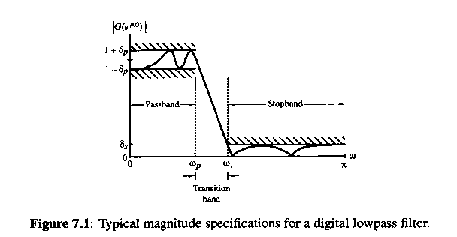
Peak ripple value
Transition band
Peak ripple value
Passband edge frequency
Stopband edge frequency

Slide 11
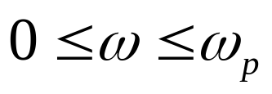
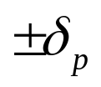
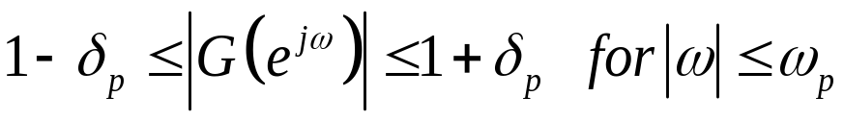
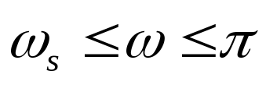

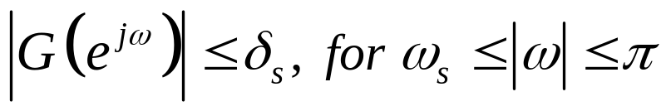
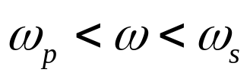
Concepts on Digital Filter
Passband
defined by
Error bound
Magnitude
Stopband
defined by
Error bound
Magnitude
Transition band

Slide 12
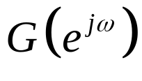
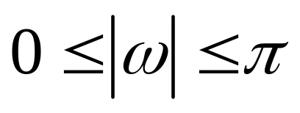
Concepts on Digital Filter
Note:
The frequency response
of a digital
filter is a periodic function of ω, and the magnitude response of a real-coefficient digital filter is an even function of ω.
As a result, the digital filter specifications are given only for the range

Slide 13
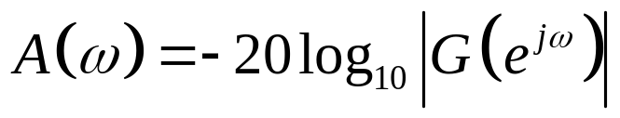
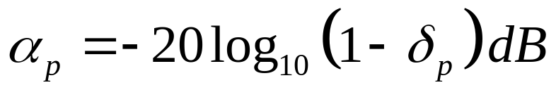
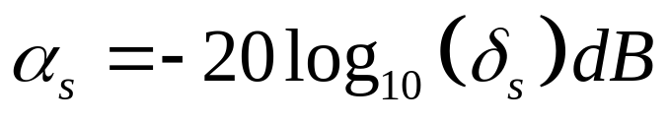
Concepts on Digital Filter
Digital filter specifications are often given in terms of loss function,
in dB. Thus
Peak passband ripple
Minimum stopband attenuation

Slide 14
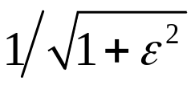
6.1 Concepts on Digital Filter
The magnitude response specifications for a digital lowpass filter may alternatively be given I a normalized form:
The maximum value of the magnitude in passband is assumed to be unity.
The maximum passband deviation, denoted as is given by the minimum value of the magnitude in the passband.
The maximum stopband magnitude is denoted by 1/A.

Slide 15
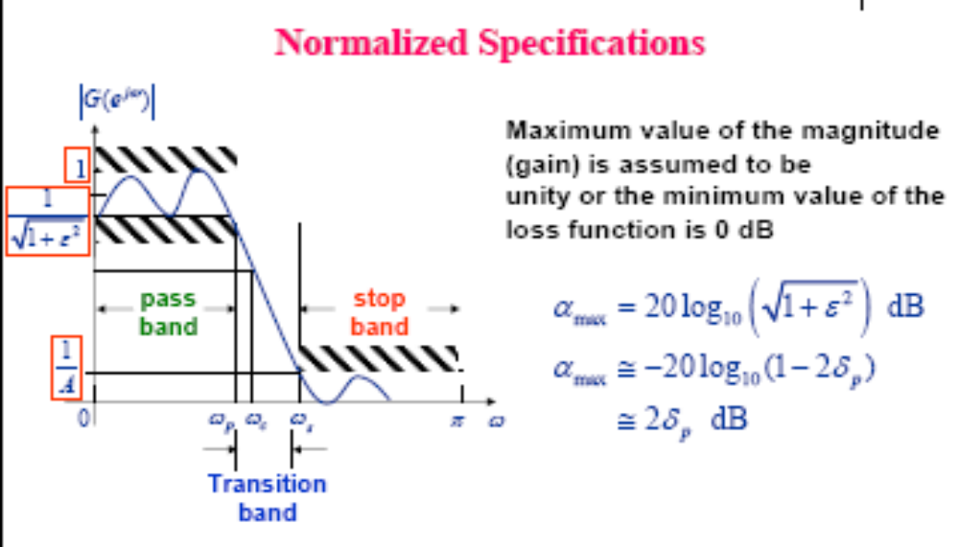
Concepts on Digital Filter
Maximum passband attenuation

Slide 16
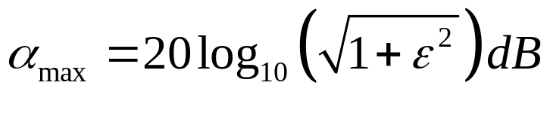

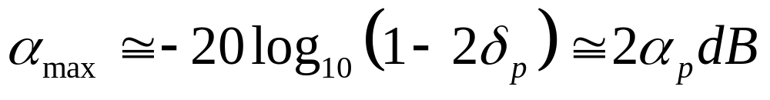
Concepts on Digital Filter
Maximum passband attenuation
For
as is typically the case, it can be shown

Slide 17
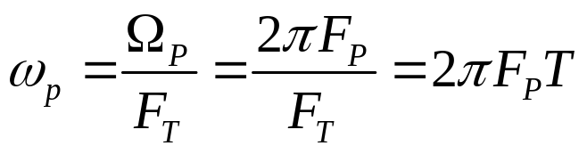
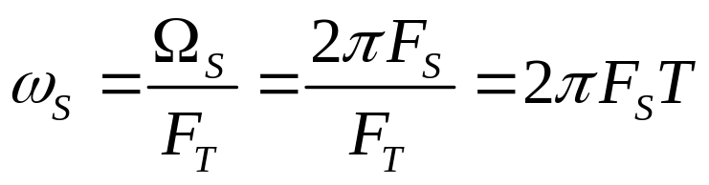
Concepts on Digital Filter
The passband and stopband edge frequencies, in most applications, are specified in Hz, along with the sampling rate of the digital. Then, the normalized angular edge frequencies in radians are given by

Slide 18
Selection of the Filter Type
Concepts on Digital Filter
The second issue of interest is the selection of the digital filter type, that is, whether an IIR or an FIR digital filter is to be employed.
The objective of digital filter design is to develop a causal transfer function H(z) meeting the frequency response specifications.

Slide 19
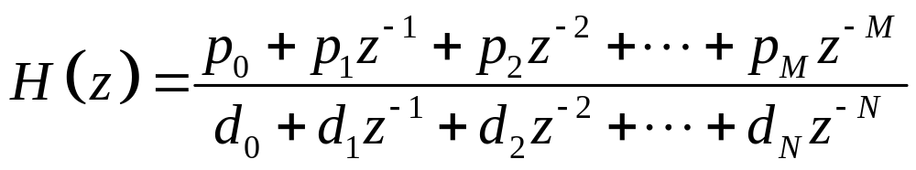
Concepts on Digital Filter
For IIR digital filter design, the transfer function is a rational function of z⁻¹ :
Moreover, H(z) must be a stable transfer function, and for reduced computational complexity, it must be of lowest order N.

Slide 20
Concepts on Digital Filter
Introduce of filter design
The approach to IIR filter design based on the conversion of a prototype analog transfer function to a digital transfer function is widely used. Then, the most common practice of IIR filter design is

Slide 21
Concepts on Digital Filter
To convert the digital filter specifications into analog lowpass prototype filter specifications.
To determine the analog lowpass filter transfer function meeting these specifications
To transform it into the desired digital filter transfer function.

Slide 22
Concepts on Digital Filter
Why is this approach used?
Analog approximation techniques are highly advanced.
They usually yield closed-form solutions.
Extensive tables are available for analog filter design.
Many applications require the digital simulation of analog filter.

Slide 23
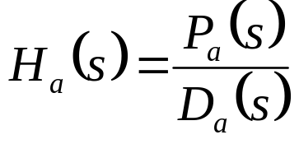
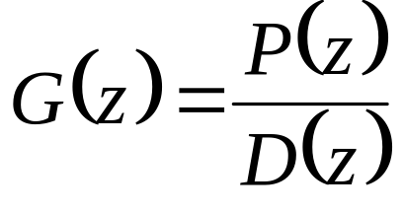
Concepts on Digital Filter
We denote an analog transfer function as
The digital transfer function derived from H_{a}(s) is denoted by

Slide 24
Concepts on Digital Filter
The basic idea behind the conversion of an analog prototype transfer function H_{a}(s) into a digital IIR transfer function G(z) is to apply a mapping from the s-domain to the z-domain so that the essential properties of the analog frequency response are preserved.

Slide 25
Concepts on Digital Filter
The mapping function should be such that
the imaginary axis in the s-plane be mapping onto the unit circle of the z-plane.
a stable analog transfer function be transformed into a stable digital transfer function.
The widely used transformation is the Bilinear Transformation and Impulse Invariance Method.

Slide 26
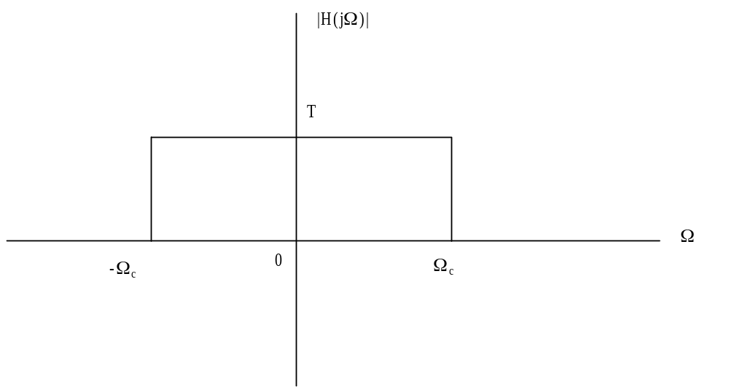
Filter specifications
The ideal lowpass filter should have a magnitude response of the form shown as follow:

Slide 27
Filter specifications
In practical, the magnitude response characteristics in the passband and in the stopband cannot be constant and are therefore specified with some acceptable tolerances. A transition band is specified between the passband and the stopband to permit the magnitude to drop off smoothly.

Slide 28
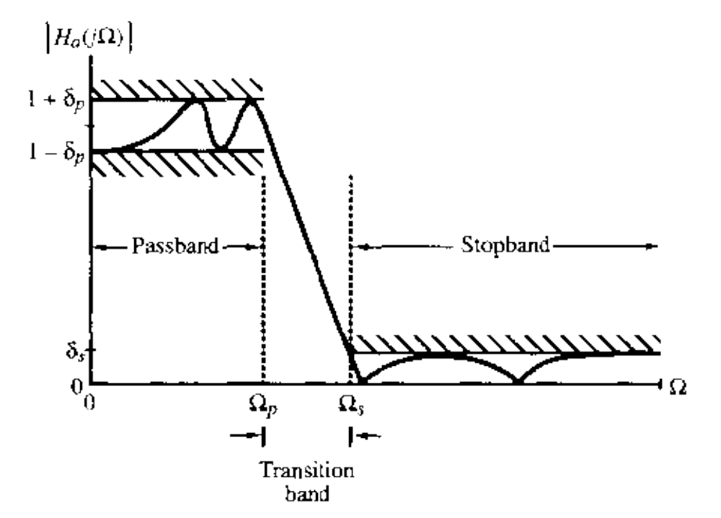
Figure 6.17 Typical magnitude specifications for an analog lowpass filter

Slide 29
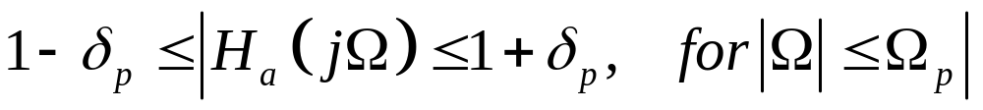
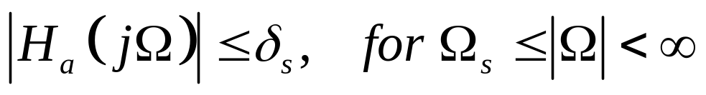
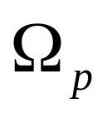

Filter specfications
Passband defined by 0≤Ω ≤ Ω_{p}, we require
Stopband defined by Ω_{s}≤Ω ≤ ∞, we require
Passband edge frequency
Stopband edge frequency

Slide 30


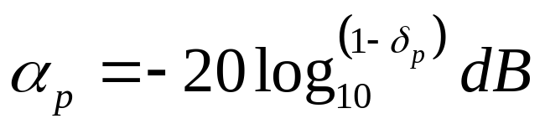
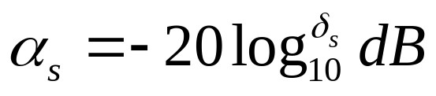
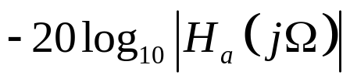
Filter specifications
Passband ripple
Stopband ripple
Peak passband ripple
Minimum stopband attenuation
The filter specifications are given in terms of the loss function or attenuation function in dB, which is defined as the negative of the gain in dB; that is ,

Slide 31
Filter specifications
The magnitude response specification for an analog lowpass filter can also be given in a normalized form in some application.

Slide 32
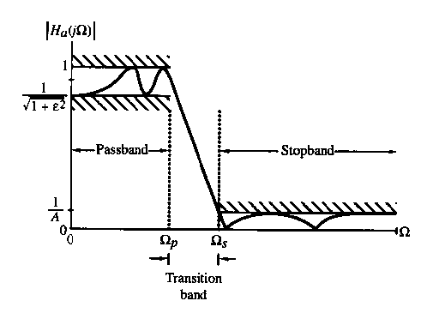
Figure 6.18 Normalized magnitude specifications for an analog lowpass filter

Slide 33
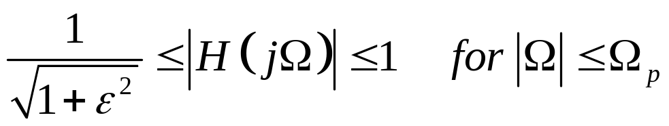
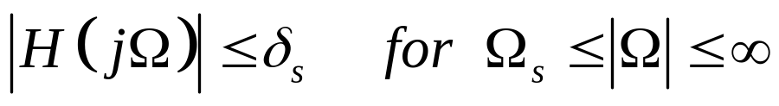
Filter specifications
Similar to a digital filter, the analog filter specification can also be given:
Passband: 0≤Ω ≤Ω_{p}
Stopband: Ω_{p} ≤Ω ≤Ω_{s}

